Slide 1
WebSphere Family Overview
Application Infrastructure
Henrik Sjöstrand
WebSphere Technical Sales
henrik@se.ibm.com

Slide 2
Agenda
WebSphere Family Overview
WebSphere Application Server v7
WebSphere CloudBurst
WebSphere Virtual Enterprise
WebSphere sMash

Slide 3
The Foundation
WebSphere Application Server is the foundation for many IBM software products, both from the WebSphere brand and from other brands such as Lotus, Tivoli, Information Management etc.
Process Server
Databases
Portal Server
(Lotus)
Services
Registry &
Repository
Business
Monitor
ESB
WebSphere Application Server
Messaging
Backend
systems
Operating System
& Hardware

Slide 4








The WebSphere product organization…
Integration and Messaging
Application Infrastructure
Connectivity
Foundation
Middleware infrastructure for integrating applications and services
Messaging backbone for facilitating the transfer of messages from application to application
Key Products: WebSphere MQ, WS Enterprise Service Bus, WS Message Broker, WS Adapters, WS Service Registry & Repository, WebSphere Business Events, Datapower appliances
Runtime environment for
deploying applications and services
E-commerce solution for
B2B and B2C transactions
Key Products: WS Application Server (WAS), WAS CE, WAS ND, WebSphere Extreme Scale, WebSphere Virtual Enterprise, WebSphere sMash, WebSphere Commerce
Business Process Management
Host Transaction Processing, OS and Utilities
Middleware infrastructure for modeling, orchestrating, and monitoring business processes
Business rules and decisions
Key Products: WS Process Server, WS Monitor,
WS Modeler, WS Business Service Fabric,
iLog Products
Application and transaction processing infrastructure and utilities for the mainframe platform
Key Products: CICS, TPF,
Comm Server, PD Tools
Enterprise
BPM

Slide 5

WebSphere Application Server Family
Multiple BusinessModels, Multiple Deployment Options
Ultimate scalability & performance; functional depth & breadth
WebSphere Application Server
for z/OS
WebSphere
Application Server
Network Deployment
(and HyperVisor Edition)
WebSphere
Extended Deployment
Customer
Needs
WebSphere
Application Server
WebSphere Application Server - Express
Reduced acquisition costs; Small footprint..
WebSphere
Application Server
Community Edition
Built on common WebSphere code
WebSphere sMash
Built on open source technology
Fast deployment of single app; low transaction volumes…
High transaction volumes, High Availability & Clustering, Centralized Administration, Advanced Web Services
Capabilities
Notes:
WebSphere sMash – Platform for agile development of situational Web 2.0 applications, extremely lightweight runtime, fits well into XD/VE environments.
WAS – Express: A turn-key solution for building and managing simple yet dynamic Web sites. Combines a robust application server with an easy to use development environment. Focused on providing lots of ease-of-use features to help customers get up and running, and productive quickly – includes graphical tools (RWD), fast installation defaults…. (It does support the complete J2EE 1.4 compatible programming model – including Servlets, JSPs, EJBs and Web services – so customers do not sacrifice core capability)
WAS: The core J2EE and Web Services application server, delivering a high-performance, scalable transaction engine for dynamic applications. Ideal for single-server environments.
WAS ND: provides all of the features of the “base” application server but adds advanced deployment services that include clustering, edge-of-network services and high availability for distributed configurations. Also adds the Web Services Gateway – for Web services that can operate across disparate application frameworks and extended Web services management capabilities
WAS for zOS - with the same programming model as WAS ND for distributed platforms, the configuration available for z/OS is specifically optimized to advantage of the unique qualities of services provided by zSeries hardware and the z/OS™ operating system
WebSphere Extended Deployment (XD) is an add-on to WAS ND that delivers a dynamically scalable, easily manageable, and high performance environment for distributed applications.
(All the above have been built on a common codebase, so your J2EE applications will continue to run - unaltered – as you move up the stack.)
WAS Community Edition, the follow-on to Gluecode Standard Edition, is a free, lightweight application server built on open source technology (Apache Geronimo) from the Apache Software Foundation. This is targeted at developers with different needs with regard to access to technology, business models/pricing/licensing, extent to which technology can be customized/embedded, footprint and so on.

Slide 6
WebSphere Foundation Family
WebSphere Application Server Express, Base & Network Deployment
  Reliable, secure, scalable JEE5 runtime with best of breed functionality
WebSphere CloudBurst Appliance
  Provides rapid provisioning of WebSphere Application Server to virtualized environments (the ”cloud”)
  Uses WebSphere Application Server Hypervisor Edition
WebSphere Application Server Community Edition (CE)
  Free-of-charge Open Source JEE5 application server based on Apache Geronimo
WebSphere Virtual Enterprise
  For ultimate performance & scalability, increased manageability, and virtualization of applications
  Not an application server runtime in itself, adds capabilities to the other runtimes
WebSphere eXtreme Scale
  Extreme performance using distributed in-memory caching distributed on multiple application servers
WebSphere XD Compute Grid
  Batch processing for Java
WebSphere sMash
  Development and runtime environment for situational Web 2.0 applications, and Enterprise mashups
  Dynamic server-side scripting using PHP and Groovy for agile development
  Clients use JavaScript, Ajax and the Dojo JavaScript framework
Notes:
sMash: http://www-01.ibm.com/software/webservers/smash/
CE: http://www-01.ibm.com/software/webservers/appserv/community/
WAS: http://www-01.ibm.com/software/webservers/appserv/was/
XD: http://www-01.ibm.com/software/webservers/appserv/extend/virtualenterprise/
WebSphere eXtreme scale: http://www-01.ibm.com/software/webservers/appserv/extremescale/
WebSphere eXtreme Scale processes massive volumes of transactions with extreme efficiency and linear scalability
Operates as an in-memory data grid that dynamically caches, partitions, replicates, and manages application data and business logic across multiple servers.
Fast application performance: Use as a powerful distributed cache to speed application access to data.
WebSphere Compute Grid: http://www-01.ibm.com/software/webservers/appserv/extend/computegrid/
WebSphere Extended Deployment Compute Grid enables the entry, execution and management of batch jobs.
When combined with the workload management capabilities in WebSphere Extended Deployment, batch jobs and online transaction processing applications can execute simultaneously.
Provides a full batch processing system, including comprehensive development and management tools, delivering a complete out-of-the-box solution for building and deploying Java-based batch applications on all platforms supported by WebSphere.

Slide 7
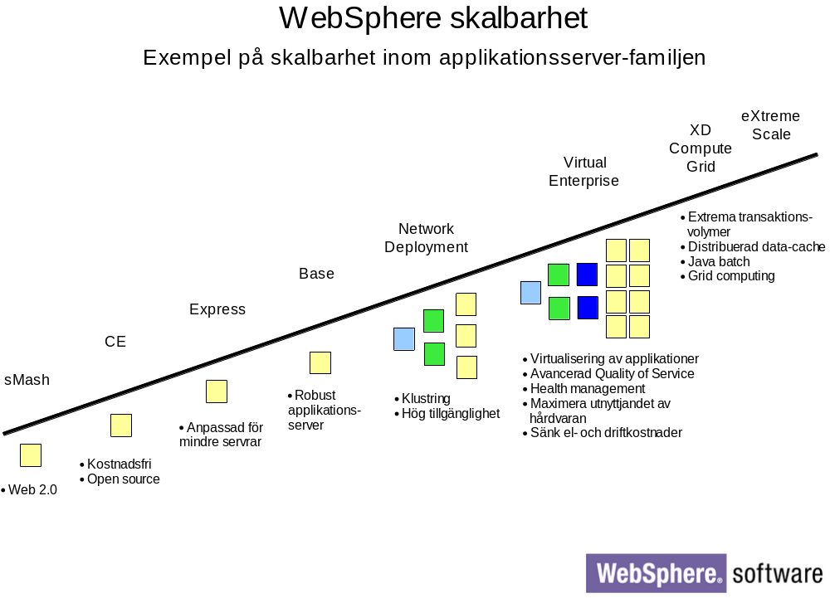
Notes:
WAS – Express: A turn-key solution for building and managing simple yet dynamic Web sites. Combines a robust application server with an easy to use development environment. Focused on providing lots of ease-of-use features to help customers get up and running, and productive quickly – includes graphical tools (RWD), fast installation defaults…. (It does support the complete J2EE 1.4 compatible programming model – including Servlets, JSPs, EJBs and Web services – so customers do not sacrifice core capability)
WAS: The core J2EE and Web Services application server, delivering a high-performance, scalable transaction engine for dynamic applications. Ideal for single-server environments.
WAS ND: provides all of the features of the “base” application server but adds advanced deployment services that include clustering, edge-of-network services and high availability for distributed configurations. Also adds the Web Services Gateway – for Web services that can operate across disparate application frameworks and extended Web services management capabilities
WAS for zOS - with the same programming model as WAS ND for distributed platforms, the configuration available for z/OS is specifically optimized to advantage of the unique qualities of services provided by zSeries hardware and the z/OS™ operating system
WebSphere Extended Deployment (XD) is an add-on to WAS ND that delivers a dynamically scalable, easily manageable, and high performance environment for distributed applications.
(All the above have been built on a common codebase, so your J2EE applications will continue to run - unaltered – as you move up the stack.)
WAS Community Edition, the follow-on to Gluecode Standard Edition, is a free, lightweight application server built on open source technology (Apache Geronimo) from the Apache Software Foundation. This is targeted at developers with different needs with regard to access to technology, business models/pricing/licensing, extent to which technology can be customized/embedded, footprint and so on.

Slide 8
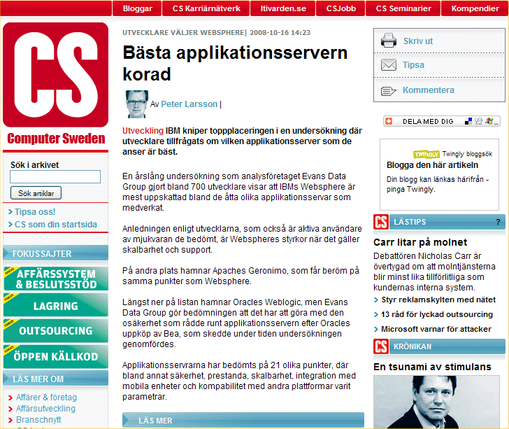
WebSphere Rated Best Application Server 2008
Notes:
http://computersweden.idg.se/2.2683/1.186055
http://www.evansdata.com/reports/viewRelease_download.php?reportID=20

Slide 9
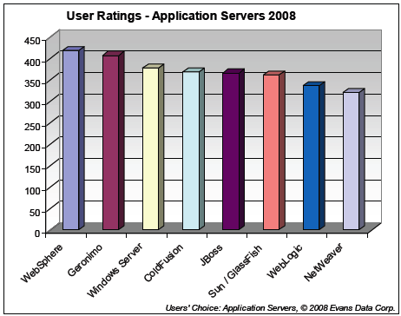
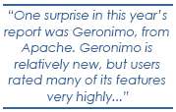


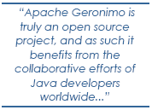
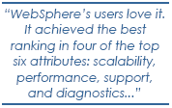
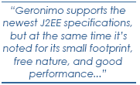
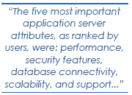
WebSphere Rated Best Application Server 2008
WebSphere
Application
Server
Apache
Geronimo

Slide 10
WebSphere Application Server
Topologies

Slide 11
WebSphere Application Server Topology
Express & Base (single server)
Internet
DMZ
Secure zone
Backends
App1
App2
AdminConsole
HTTP
WAS
Web
Server
Application
Server
Notes:
Express/Base setup contains only HTTP server w/ plugin (yellow box) and an Application Server.
The application server (white box) is a single instance of the JVM and this JVM can host multiple applications, EAR files.
Administration is done using the AdminConsole, which also runs inside the JVM.
IBM HTTP Server (IHS) is based on Apache HTTP server.

Slide 12
WebSphere Application Server Topology
Network Deployment
Internet
DMZ
Secure zone
App1
App2
App3
App4
Admin
Console
HTTP
DMgr
App3
App4
WAS
Web
Server
Application
Servers
Notes:
In the Network Deployment setup we install a Deployment Manager (DMgr) which takes care of all the configuration of the whole ”cell”.
The Dmgr can start/stop/install/uninstall/configure etc. all applications and servers in the cell.
Application servers can be clustered to provide high availability and fail-over.
Sessions can be replicated memory-memory between application servers, or persisted to database.
The HTTP Plugin takes care of routing the requests to the right server and provides affinity for users HTTP sessions.
Each node has its own node agent (dark grey boxes) with which the DMgr communicates.
Clusters are static clusters - each physical server has to have enough capacity to handle the applications it hosts.
WAS supports mixed-version cells. You can mix different versions of WAS nodes in the same cell. The DMgr should always be at the highest level.

Slide 13
WebSphere Application Server Topology
Network Deployment w/ Edge
Internet
DMZ
Secure zone
App1
App2
App3
App4
Admin
Console
DMgr
App3
Edge
HTTP
App4
WAS
Load
Balancers
Web
Servers
Application
Servers
Notes:
For even better high availability and fail-over the Edge server (part of ND) can be added. Edge provides load balancing features and can spray requests among multiple HTTP servers.

Slide 14
WebSphere Application Server Topology
Virtual Enterprise (XD)
Internet
DMZ
Secure zone
Dynamic clusters distributes the load!
App1
App2
App3
App3
App4
Admin
Console
DMgr
App3
Edge
HTTP
ODR
App4
WAS
Load
Balancers
Web
Servers
OnDemand
Routers
Application
Servers
Notes:
With WebSphere XD/Virtual Enterprise the OnDemand Router (ODR) provides even more intelligent routing, queueing, and prioritization of work. SLAs can be defined for applications and XD/VE takes care of distributing the applications on the available hardware in order to meet the SLAs. This is all done dynamically and as a response to incoming traffic load. The ODR measures response times, and the XD agent (light gray box) measures resource consumption (CPU etc.) on the servers.
XD/VE can also prioritize traffic and give certain IP addresses (companies) a higher priority than others. XD/VE also provdes features for rolling out new versions and testing in production environment, sending users to a busy page if backend servers are slow.

Slide 15
WebSphere Application Server Topology
Virtual Enterprise (XD)
Internet
DMZ
Secure zone
WAS
WASCE
sMash
Edge
HTTP
ODR
Other
WebLogic
Jboss
Tomcat
etc.
Load
Balancers
Web
Server
OnDemand
Routers
Application
Servers
Notes:
With WebSphere XD/Virtual Enterprise the OnDemand Router (ODR) provides even more intelligent routing, queueing, and prioritization of work. SLAs can be defined for applications and XD/VE takes care of distributing the applications on the available hardware in order to meet the SLAs. This is all done dynamically and as a response to incoming traffic load. The ODR measures response times, and the XD agent (light gray box) measures resource consumption (CPU etc.) on the servers.
XD/VE can also prioritize traffic and give certain IP addresses (companies) a higher priority than others. XD/VE also provdes features for rolling out new versions and testing in production environment, sending users to a busy page if backend servers are slow.

Slide 16





WAS XD Support for Middleware Platforms
Three categories of support for middleware server types…
  Complete Lifecycle Management
    Create/remove server instances
    Govern all aspects of server configuration
    Provide operational control
    Deploy applications
    Server health and performance is monitored and visualized.
Application Server 6.1
Community Edition 2.0
  Assisted Lifecycle Management
    Provides specific templates for creating representations of existing servers and applications
    Servers can be controlled operationally
    Administrative utilities are provided to manage the external configuration and runtime
    Server health and performance is monitored and visualized.
Tomcat
  Generic Lifecycle Management
    Provides generic templates for the user to manually define servers and operational commands.
    Control server operations and monitor health and performance
Notes:
With WebSphere XD, the WebSphere family along with WASCE are supported as “Complete Lifecycle Management” servers with features like controlling server instances and deploying applications. The open source challengers are supported under “Assisted Lifecycle Management”.

